Slide 1
Treasurer’s Report
LPKY
21 Feb 2026

Slide 2
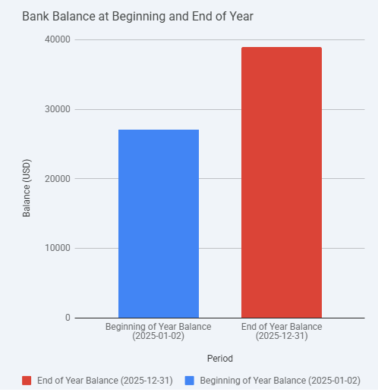
$38,947.89
$27,065.36
Income $18,150.36
Expenses
$-6267.83

Slide 3
Expenses
1/22/2025 | PURCHASE KY BOARD ELECTIONS | Voter Data | -2055
4/11/2025 | PURCHASE KY BOARD ELECTIONS | Voter Data | -2055
10/9/2025 | PURCHASE FRIENDSOFFICE | Brochures | -398.49
12/10/2025 | PURCHASE WENDY4KY.COM | Candidate Match | -200
4/16/2025 | PURCHASE USPS PO BOXES ONLINE | Mailing | -188
5/23/2025 | PURCHASE GOOGLE *TWITTER | Social Media | -121.89
7/21/2025 | INTUIT * QBooks Online | Accounting | -890.40

